Slide 1
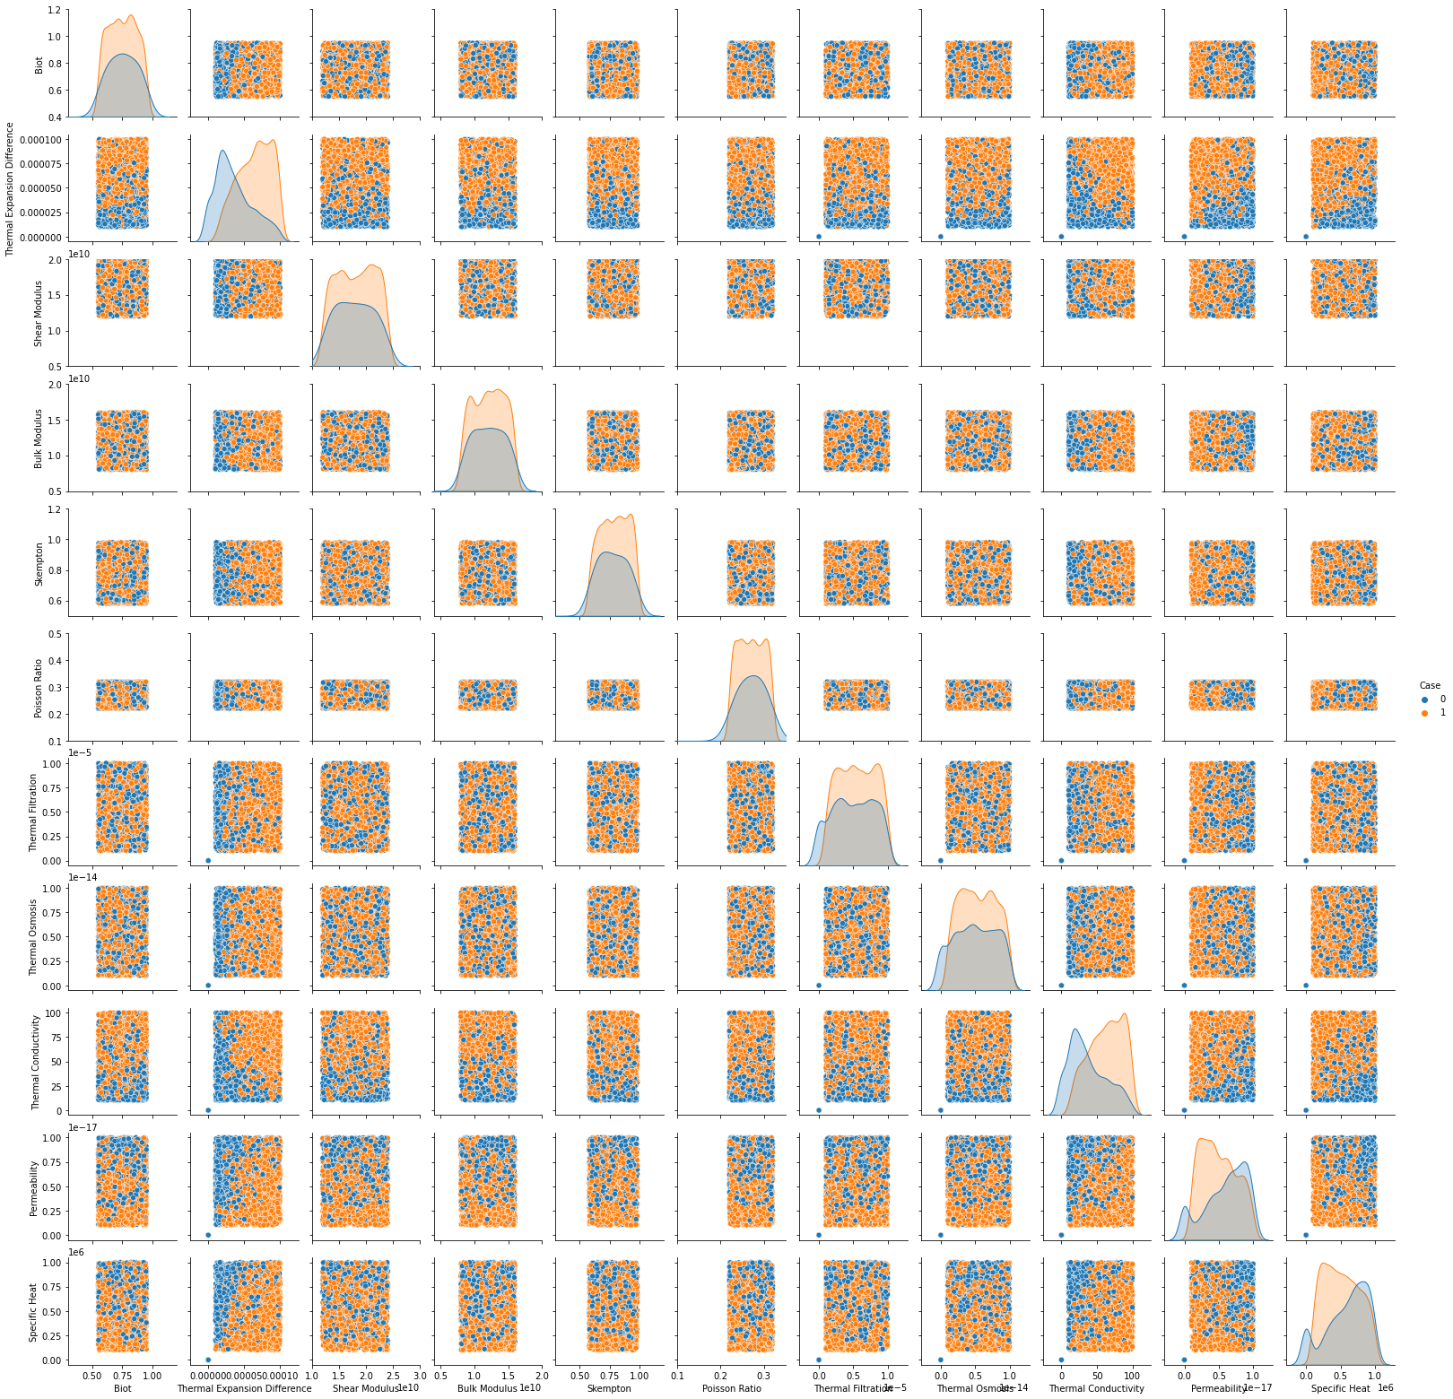

Slide 2
Transition Zone
Damage Zone
Safe Zone
Zeta Two: MND
Zeta One: HTND

Slide 3
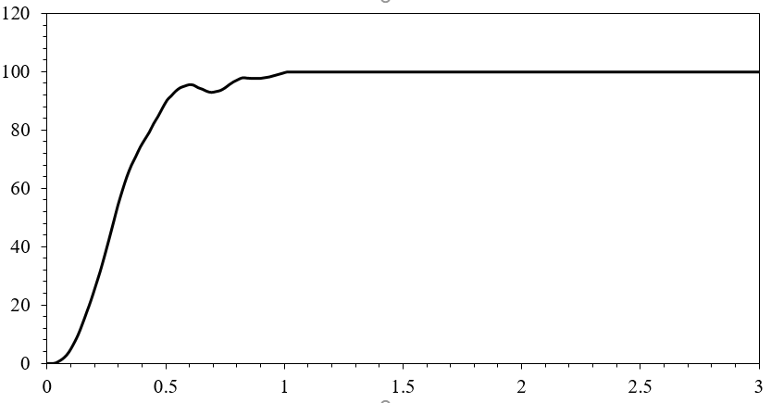
Probability of Generating Tensile Case(%)
Zeta One: HTND

Slide 4
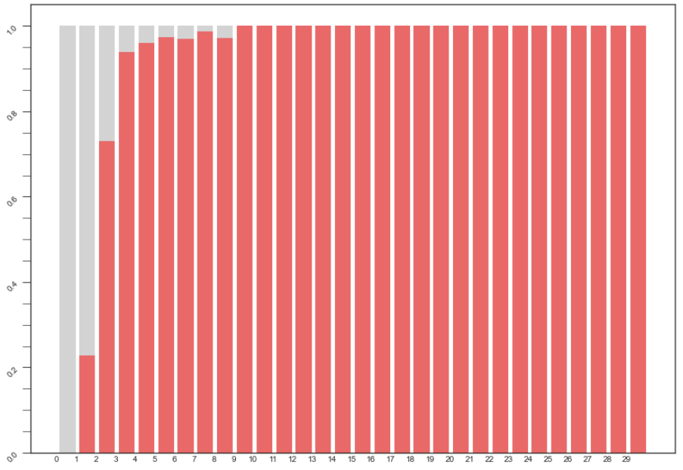
100 %
75 %
Probability of Generating Tensile Cases
50 %
0
25 %
0 %
0.6
0.7
0.8
0.9
1.1
1.2
1.3
1.4
1.5
1.6
1.7
1.8
1.9
2.0
2.1
2.2
2.4
2.5
0
0.1
0.2
0.3
0.4
0.5
1
2.3
2.6
2.7
2.8
2.9
3
Zeta One: HTND

Slide 5
Cumulative Distribution Function (CDF)
Zeta One: HTND

Slide 6
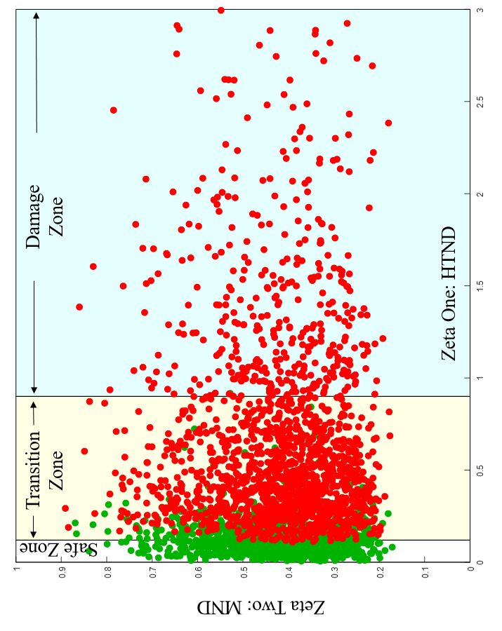
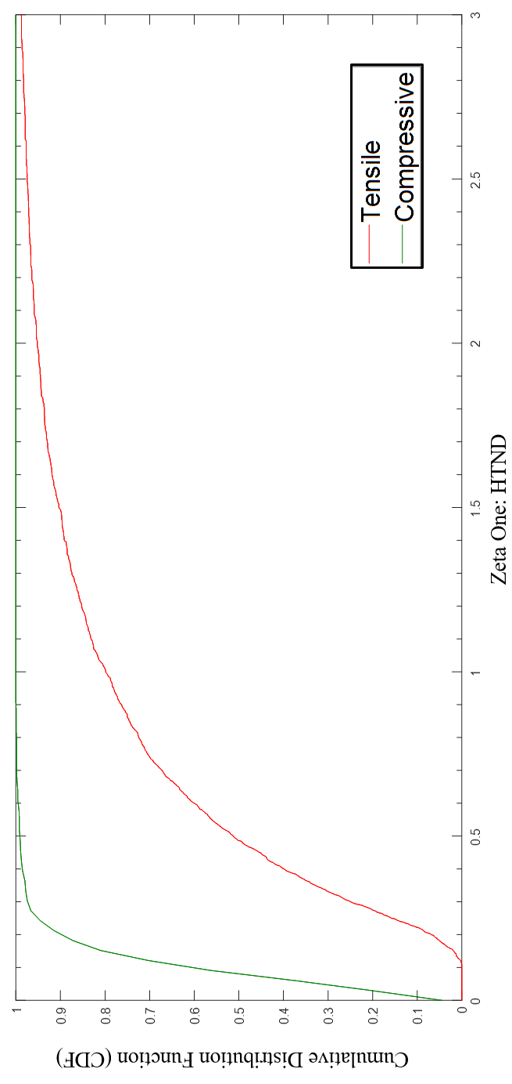
Tensile Case
Compressive Case

Slide 7
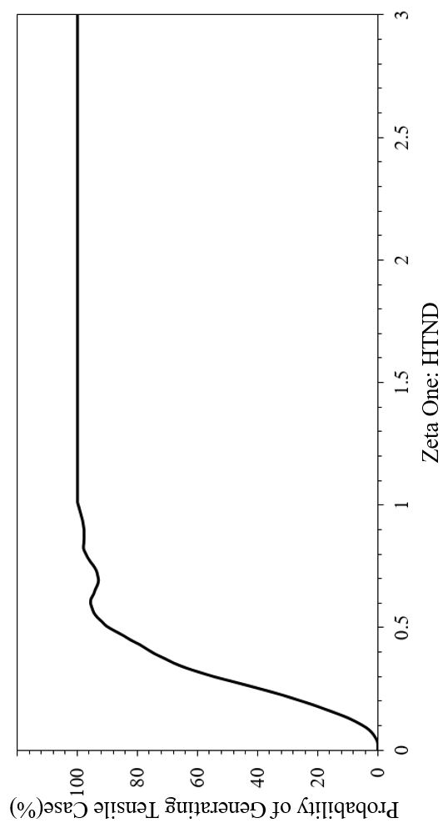
Tensile Case
Compressive Case

Slide 8
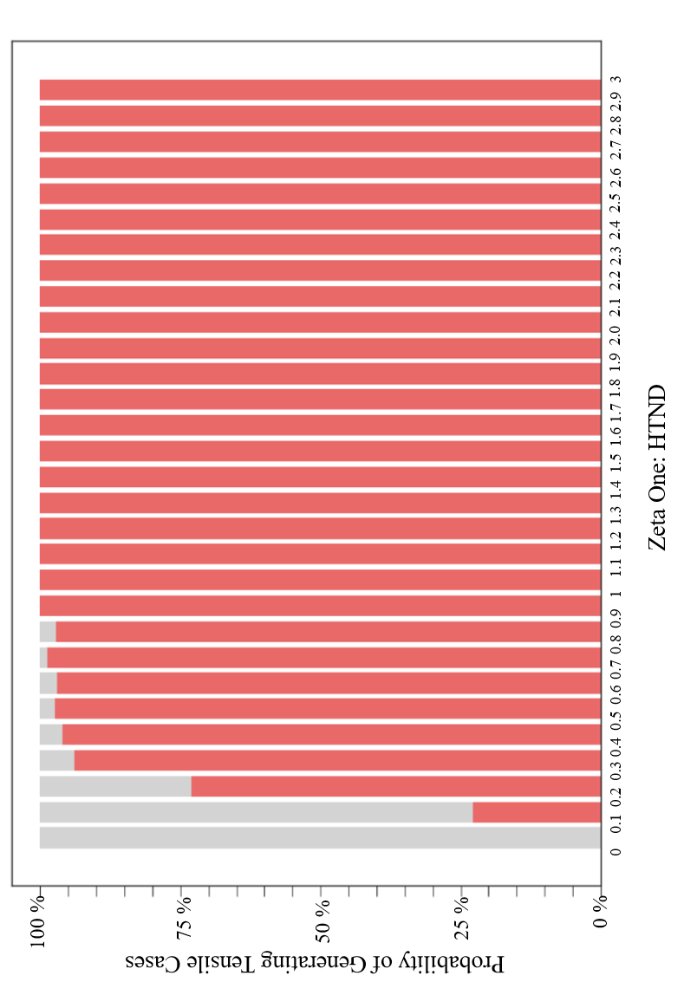
Tensile Case
Compressive Case

Slide 9
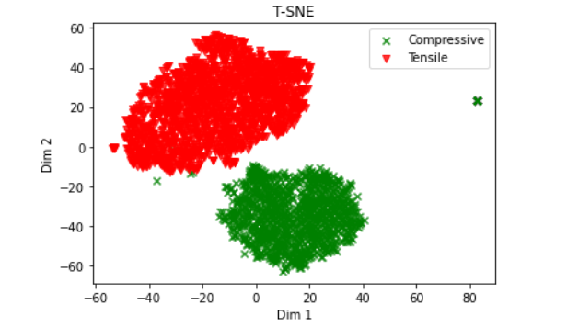
Non linear dimensionality reduction technique - t-distributed Stochastic Neighborhood Embedding (t-SNE)
Chrome-extension://efaidnbmnnnibpcajpcglclefindmkaj/https://economics.yale.edu/sites/default/files/files/Faculty/Tsyvinski/tSNE_draft15.pdf

